Slide 1
Smart Energy Consumption
Sub-Metered Household Data Analysis
Rutgers Center for Innovation Education Course of Study: Data Analytics/Big Data
Researched Performed by Antonina Pearl

Slide 2
Agenda
Business Analysis Goals, Objectives, and Data Information
Customer Energy Consumption Patterns
Residential Households and Electric Power Suppliers
Predictive Modeling for Future Economical Energy Use
Summary and Recommendations

Slide 3
objectives
Develop data analytics to prove that installation of electrical sub-metering devices, which measure power consumption and energy usage, could be a big step towards the developer's goal of providing additional value to their customers.
Gain insights from the data into any factors that can explain how homeowners use electric power
Provide economic incentive recommendations to homeowners.
The company and its customers need to understand if the benefit of installing sub-metering devices is likely to be sufficient to justify its cost.

Slide 4
Data information
A file of 2,075,259 measurements of electric power consumption in one household captured at a one-minute interval between December 2006 and November 2010 (47 months).
The file contains the following data elements/measures:
Date in format dd/mm/yyyy
Time in format hh:mm:ss
Active power measure (in kilowatt)
Reactive power measure (in kilowatt)
Voltage measure (in volt)
Current intensity (in ampere)
Sub-meter #1 (in watt-hour of active energy-- it corresponds to the kitchen, containing mainly a dishwasher, an oven and a microwave)
Sub-meter #2 (in watt-hour of active energy -- it corresponds to the laundry room, containing a washing-machine, a tumble-drier, a refrigerator and a light)
Sub-meter #3 (in watt-hour of active energy -- it corresponds to an electric water-heater and an air-conditioner)

Slide 5
Data quality
The dataset contains some missing values in the measurements (nearly 1,25% of the rows).
The fact that there were no readings available across all power measures suggests that it was not sub-meters related issue. It is possible that there was no power on those days.
The percentage of missing data was disregarded in this analysis since it did not statistically affect the general patterns on energy consumption.
We used only years of data where all months were represented (2007-2009).

Slide 6
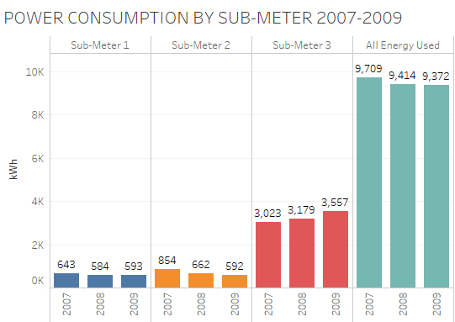
Entire energy consumption for the household as well as sub-meters 1 and 2 decreases yearly, while sub-meter 3 shows steady increase. Why?

Slide 7
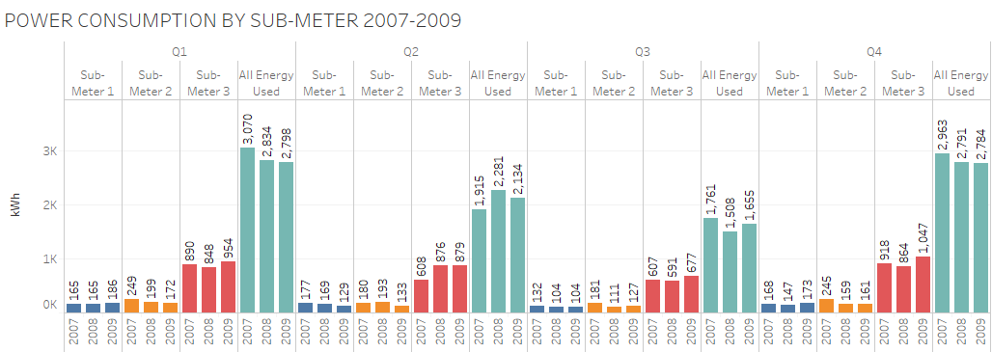

Slide 8
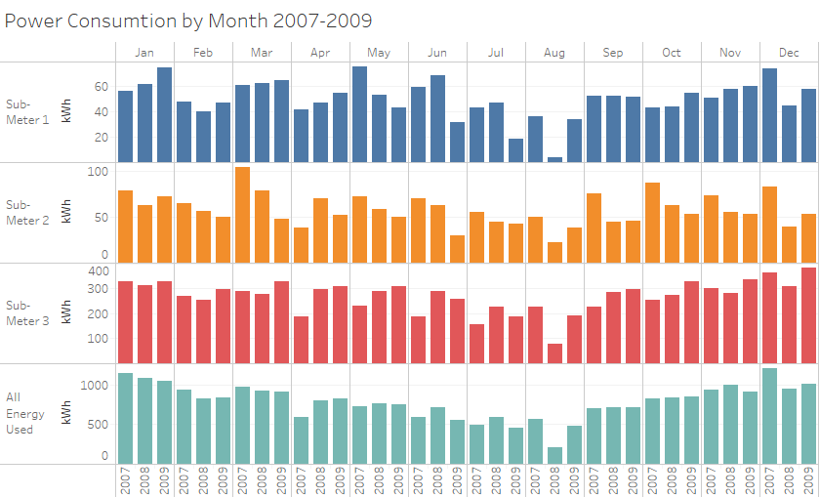

Slide 9
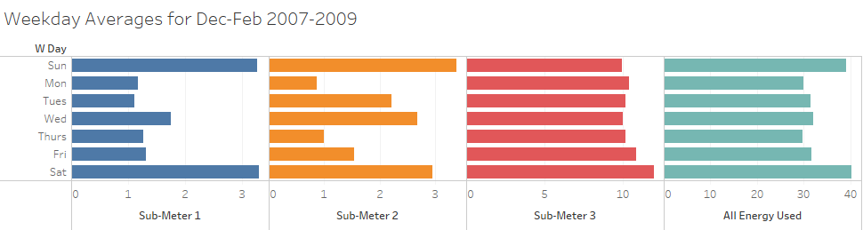

Slide 10
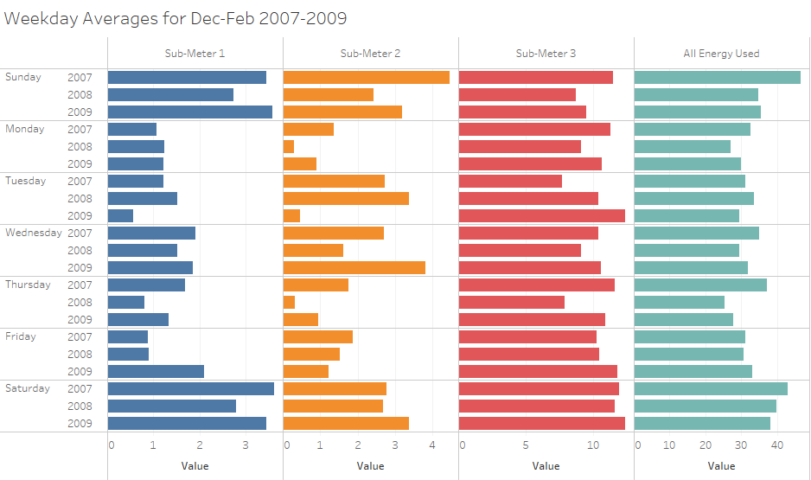

Slide 11
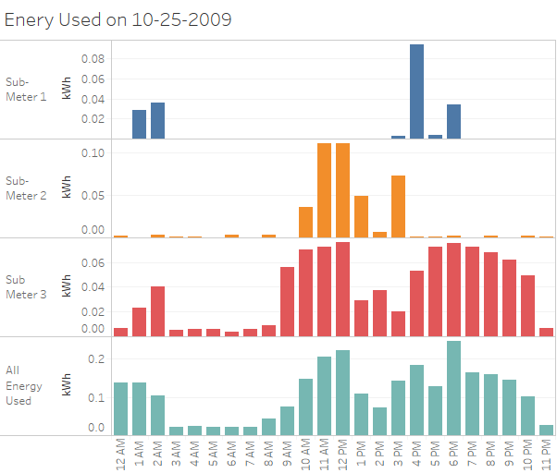

Slide 12
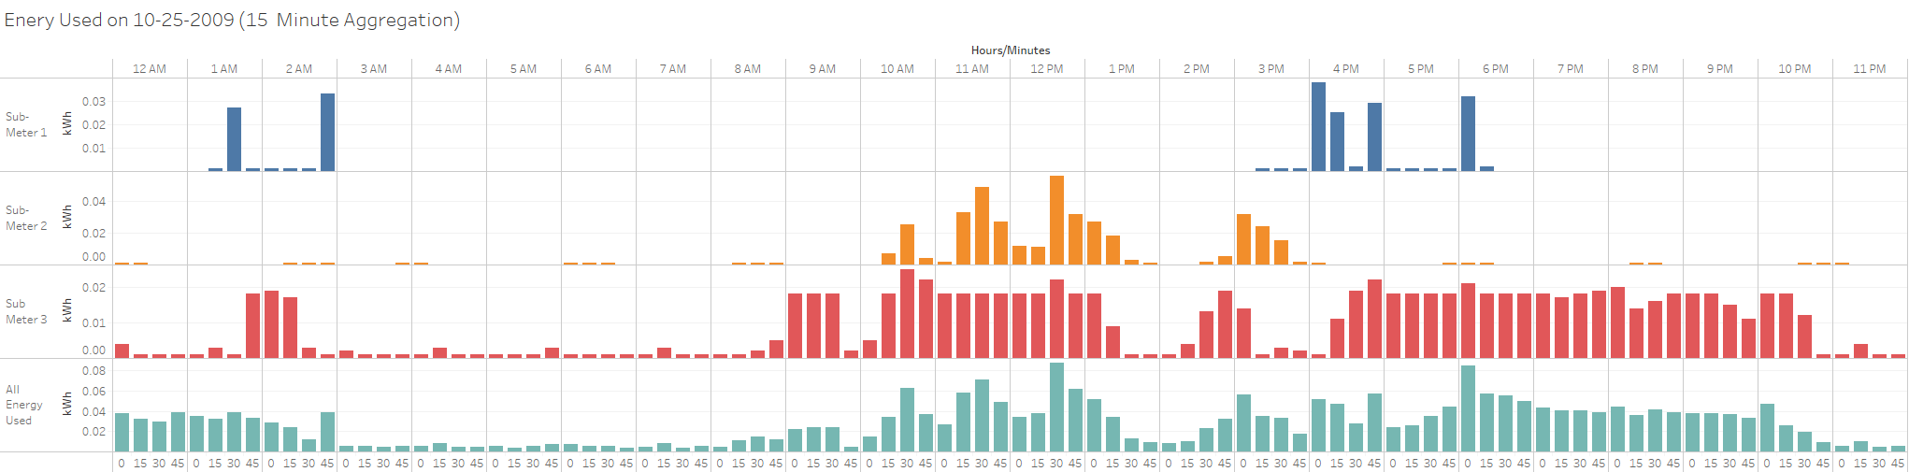

Slide 13
A smart meter grants you constant access to accurate, up-to-the-minute readings of your energy usage. You’ll know exactly how much energy you’re using, allowing you to adjust your habits accordingly.
some providers even offer an app for you to check in on your energy on the go!

Slide 14
Building "smart homes" that supply home owners with analytics on their power usage will deliver the value the developer seeks.

